Slide 1
Friday 17th November 2023
Dear Families,
At the beginning of the week it was wonderful to welcome Mary Thorne, our LDBS advisor, into school. She spent time in classrooms and worked with teachers. We had some very positive feed back including: classrooms having purposeful learning environments, children focused and engaged and strong behaviours for learning.
On Wednesday Years 4, 5 & 6 watched a performance by ‘Chain reaction - Knowing Me Knowing you, which uses drama and song to explore the dilemmas faced by a pupil who does not fit in with the crowd and is excluded for being different.
On Thursday Eco Warriors from Years 5 & 6 Collected an award from the London Children’s Flower Society for – The garden of greatest educational value. Well done to Lev, Kieran, Lyra and Freya for being fantastic ambassadors for the school!
Finally, on Friday the Buddhist centre joined year 4 for a workshop. The children learnt about the story of Buddha and what it is like to live a Buddhist life. They finished with an assembly for Years 3, 4, 5 & 6.
Wishing you a lovely weekend!
Thursday 7th December
Christmas jumper day & Christmas Lunch ??
Thursday 14th December at 2pm
Christingle at All Saints All Parents and Guardians Welcome!
Wednesday 20th December
last day of term school finishes at 1:30pm
This Week’s Attendance
1st Place: Y2 97.78
2nd Place: Reception 94.07
3-Place: Y6 95.19
Congratulations to our top 3 classes our target is 96%

Slide 2
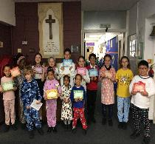
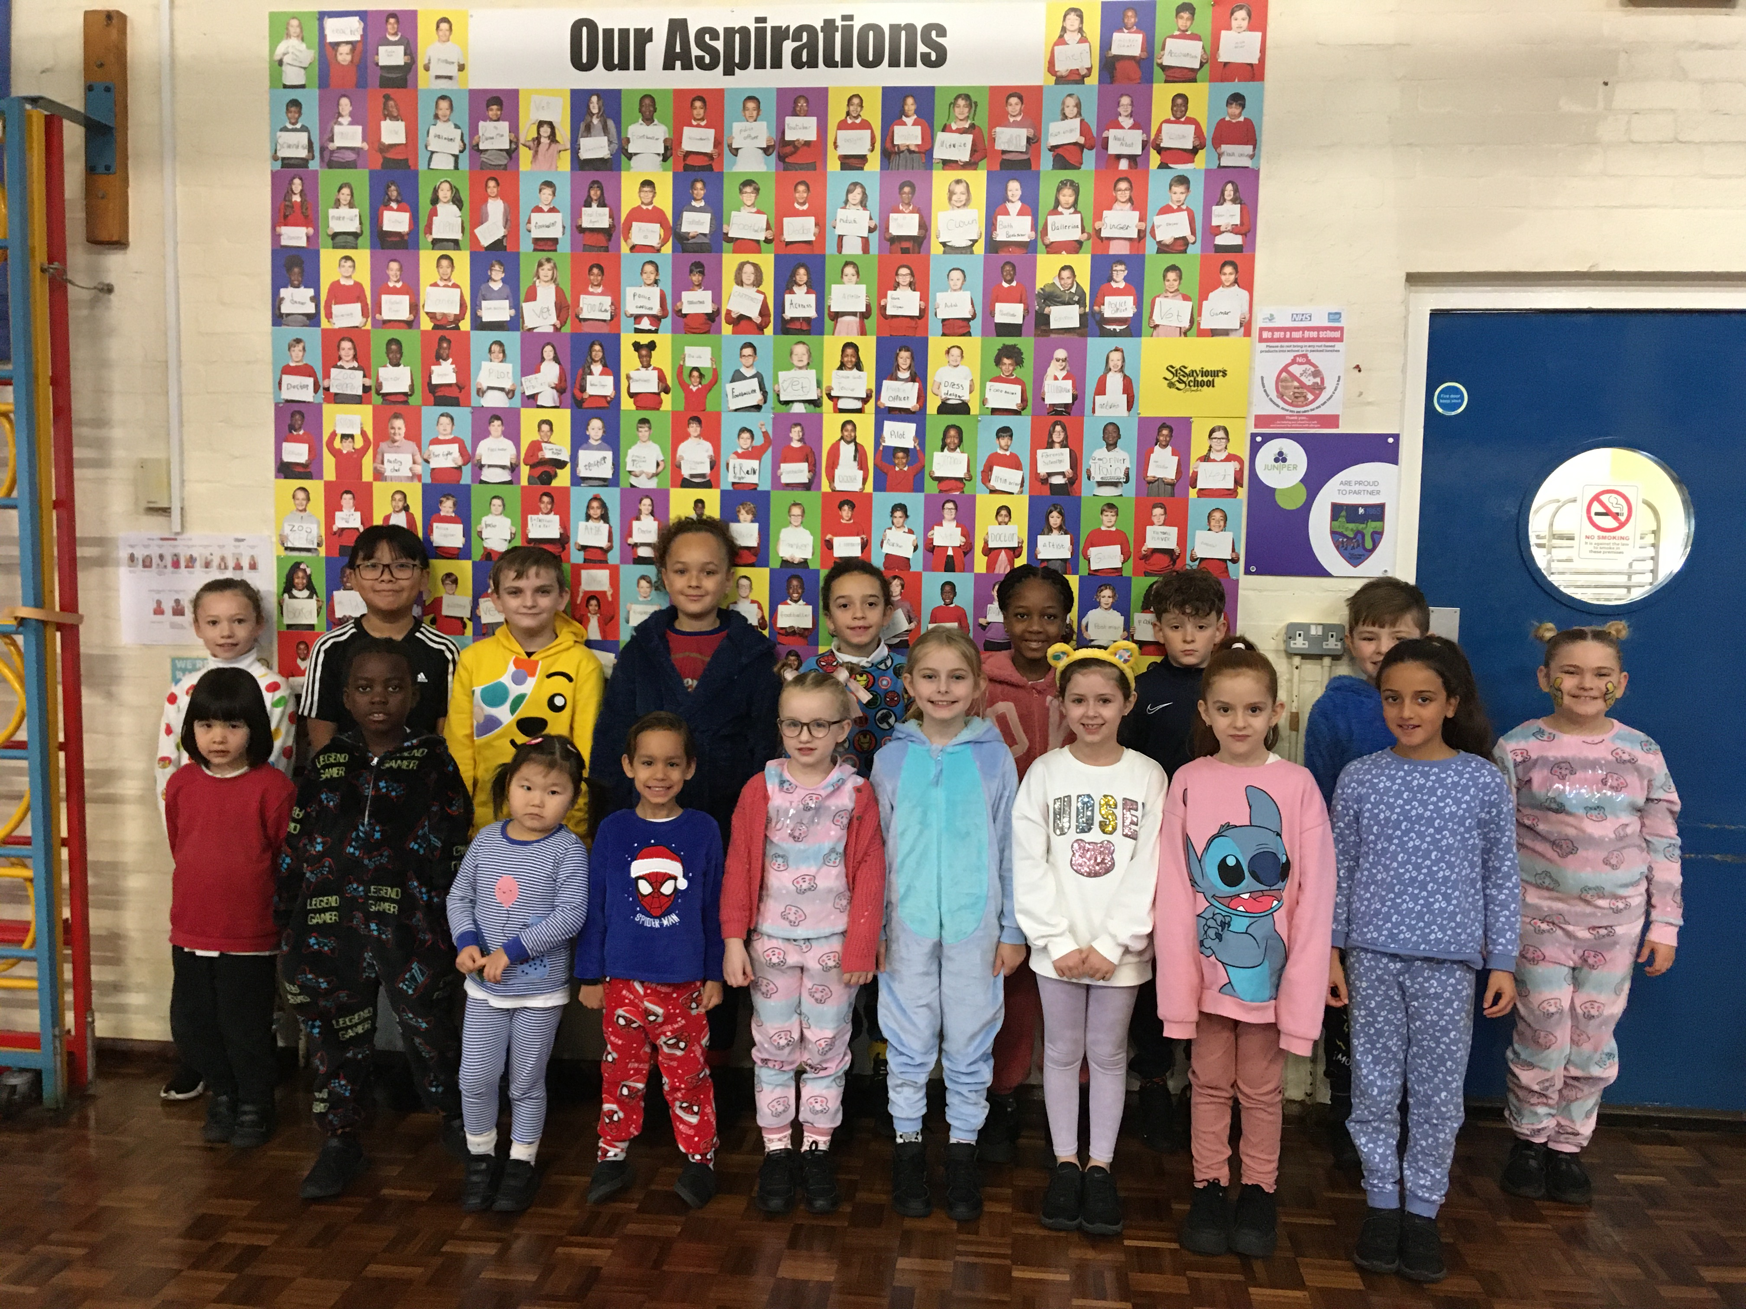
Jackson A
Ayah
Nobody knows the time that Jesus will return, his followers are to remain alert and keep doing good.
Xingchen
Henry
Nada
Tiwatope
Annie
Ricky
Tilly
Aadvik
How can you make a change in the world?
Lyra
Emily
George
Eloise

Slide 3
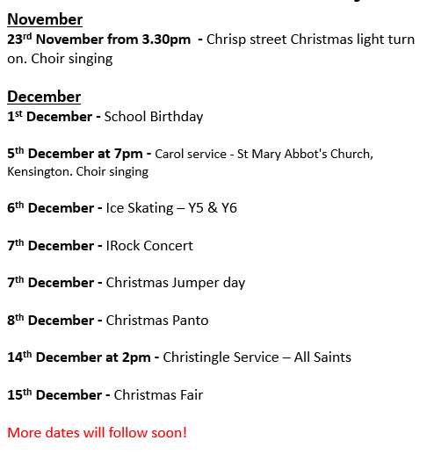
Some dates for the diary

Slide 4
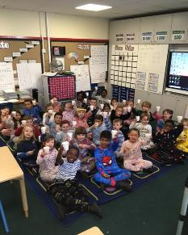
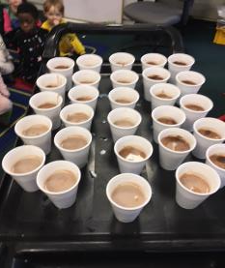

Reward of the week!
A big well done to our fantastic Year 2 class, who have won the attendance cup for 3 weeks in a row. To celebrate their high attendance, as well as receiving the cup, the children had hot chocolate and biscuits to celebrate.
Well done Year 2!
1st Place: Y2 97.78
2nd Place: Reception 94.07
3-Place: Y6 95.19
Congratulations to our top 3 classes our target is 96%

Slide 5


Deana | 17th | Reception
Aron | 18th | Yr3
Parker | 19th | Yr4
Juno | 20th | Nursery
Nico | 20th | Nursery
Alanna | 21st | Yr2
Logan | 21st | Yr6
Kieran | 22nd | Yr6
Alexander | 24th | Yr3
Bertie | 25th | Yr6
Ruby | 26th | Nursery
Zayan | 30th | Yr1

Slide 6



Slide 7
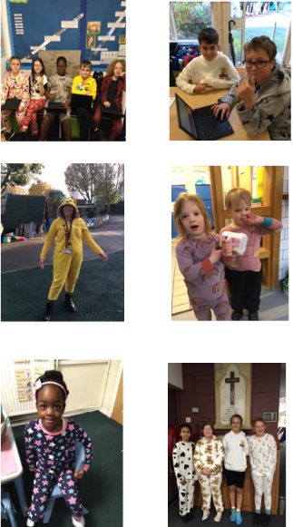
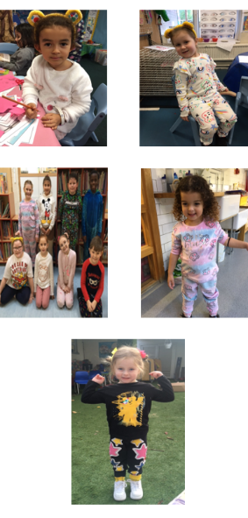
Thank you!
We are so grateful for your donation and supporting this amazing cause!

Slide 8

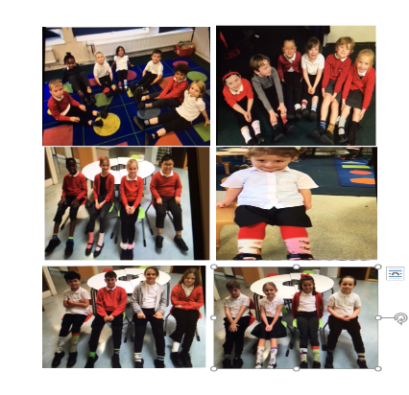
ANTI-BULLYING WEEK
It is a day when schools, workplaces, and individuals join together to show that it's okay to be different and to stand up against bullying and discrimination.

Slide 9


